Slide 1

MySQL
Course Introduction
SoftUni Team
Technical Trainers
Software University
https://softuni.bg

Slide 2
Table of Contents
Course Objectives & Program
The Trainers Team
Course Organization
Homework
Exam
Resources

Slide 3
Have a Question?
sli.do #java-db

Slide 4











SoftUni Diamond Partners

Slide 5



Educational Partners

Slide 6

Database Basics
Course Objective & Program

Slide 7
Course Objectives
The MySQL course provides
Basic database and query concepts
Establishes fundamentals for further DB trainings
Content: SQL syntax, data types, programmability
What is NOT covered?
Client-side implementations
API Libraries

Slide 8



Course Topics
Introduction to Databases. Data Definition and Datatypes
Basic CRUD, intro to SQL
Built-in functions
Data aggregation
Table Relations
Subqueries and JOINs
Functions, Triggers, Transactions

Slide 9

The Trainers Team

Slide 10
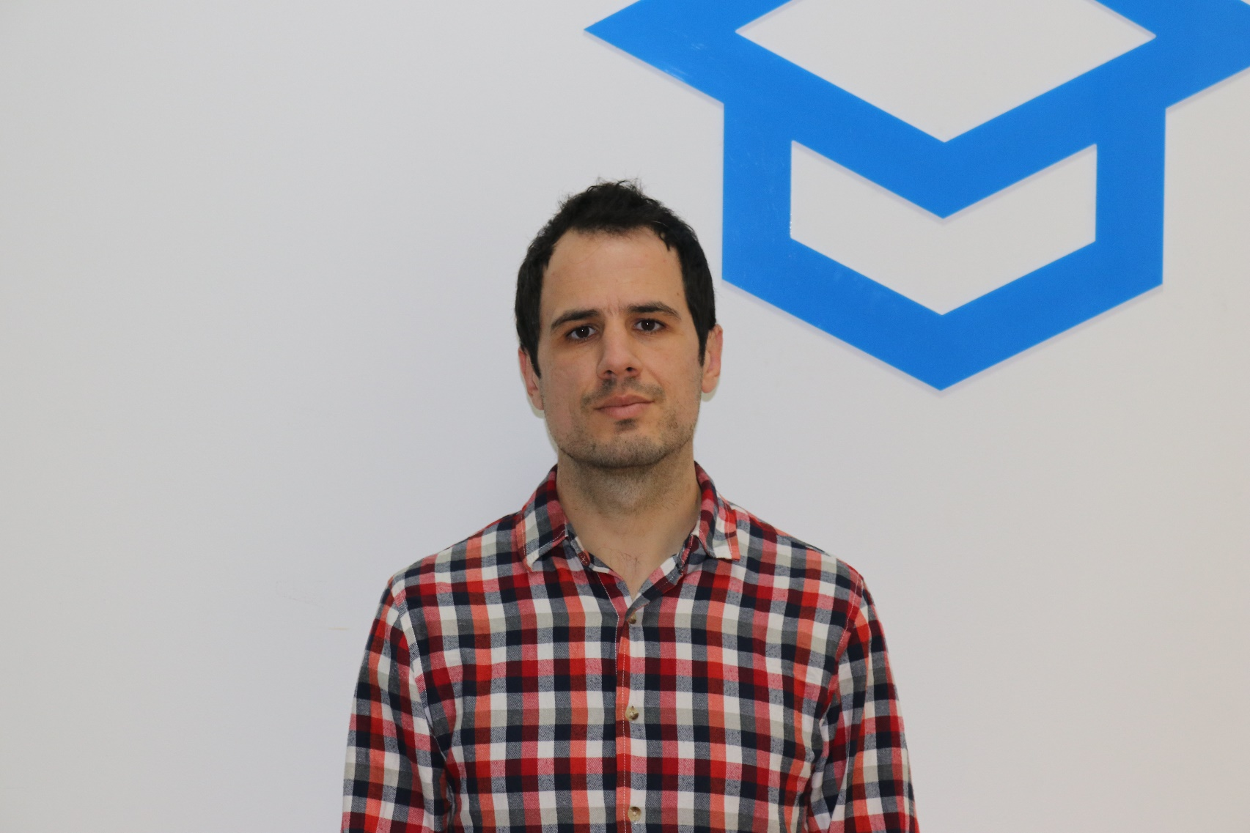
Veselin Vachev
Team Lead @ Netinfo
9 years full-stack web developer
Back-end / front-end, SEO, UX
Making CD / CI Systems
Current projects: Gong.bg, Nova.bg, Dariknews.bg, Vesti.bg, Sinoptik.bg

Slide 11

Chavdar Mitkov
Technical Trainer @ SoftUni
Team Lead of:
Java DB Module January 2020
Java Web module May 2020
Experience with MySQL , Hibernate, Spring MVC
Interested in Java, JavaScript, Angular, Kotlin

Slide 12

Course Organization

Slide 13
Java DB Module – Timeline
20-May-2021
21-June-2021
01-Aug-2021
13-Aug-2021
MySQL
4 weeks * 4 times / week
12 credits
Start: 20-May-2021 Final exam: 20-June-2021
Spring Data
7 weeks * 4 times / week
15 credits
Start: 21-June-2021
Final exam: 01-Aug-2021
Re-Take Exams MySQL 06-Aug-2021 Spring Data 13-Aug-2021

Slide 14


SoftUni Certificate
Practical Exam 100%
Homework 5%
Evaluation
14

Slide 15
CPE Certificate
Practical Exam
Theoretical Exam
Evaluation
15

Slide 16

Homework Assignments & Exercises
Your homework is mainly work in class!
Lesson days → slides + live demos + exercises
Exercise days → only exercises
How to submit your homework?
Submitted in the judge system
Do your homework when it's due!
Assignments pile up quickly

Slide 17
Exam
Section 0: Database Overview
You are given an Entity / Relationship Diagram of some Database.
Section 1: Data Definition Language (DDL)
Data Types, Constraints
Section 2: Data Manipulation Language (DML)
Insert, Update, Delete
Section 3: Querying
Data Extraction
Section 4: Programmability
Functions and Procedures

Slide 18
Resources
What We Need Additionally?

Slide 19



Java DB Course Web Site and Forum
Official web site:
Official discussion forum:
Official Facebook group:
https://softuni.bg/trainings/2752/mysql-may-2021
https://softuni.bg/forum/categories/77/databases-basics-mysql
https://www.facebook.com/groups/JavaDBMay2021/

Slide 20


The DB Basics MySQL Slides and Videos
All lecture slides, videos, homework assignments, projects and other resources are open content, available for free
Visit the course web site to access the course resources

Slide 21

Java DB Recommended Software
Software needed for this course:
Microsoft Windows 10
Workbench - https://dev.mysql.com/downloads/workbench/

Slide 22



Learn to Search in Internet
The course assignments require to search in Internet
This is an important part of the learning process
Some exercises intentionally have no hints
Learn to find solutions!
Software development includes everyday searching and learning
No excuses, just learn to study!
Developers learn new technologies, tools, languages every day!

Slide 23
Questions?
Notes:
23

Slide 24
Trainings @ Software University (SoftUni)
Software University – High-Quality Education, Profession and Job for Software Developers
softuni.bg, about.softuni.bg
Software University Foundation
softuni.foundation
Software University @ Facebook
facebook.com/SoftwareUniversity
Software University Forums
forum.softuni.bg
Notes:
24

Slide 25

License
This course (slides, examples, demos, exercises, homework, documents, videos and other assets) is copyrighted content
Unauthorized copy, reproduction or use is illegal
© SoftUni – https://about.softuni.bg/
© Software University – https://softuni.bg
Notes:
25

